Slide 1
Chapter 4: Intermediate SQL

Slide 2
Chapter 4: Intermediate SQL
Join Expressions
Views
Integrity Constraints
Notes:
1

Slide 3
Joined Relations
Join operations take two relations and return as a result another relation.
A join operation is a Cartesian product which requires that tuples in the two relations match (under some condition). It also specifies the attributes that are present in the result of the join

Slide 4
Types of Join: Natural join
Natural Join:
  Links tables by selecting rows that have common values in their common attributes
Schema of the output is same as that of cross-product.
Fewer tuples than cross-product, might be able to compute efficiently

Slide 5
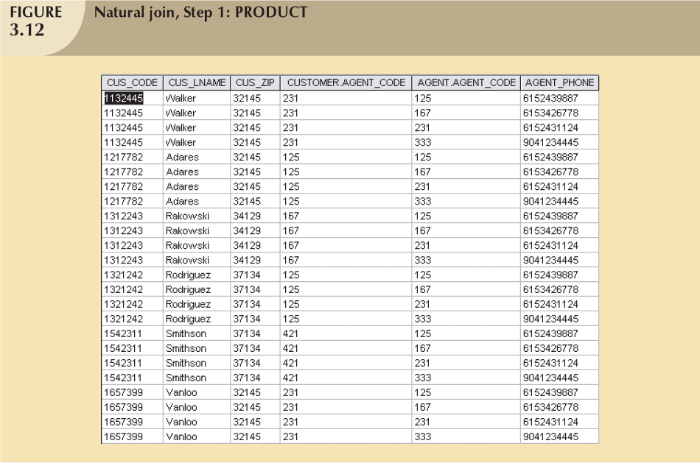
Select where
CUSTOMER_AGENT_CODE = AGENT AGENT_CODE

Slide 6
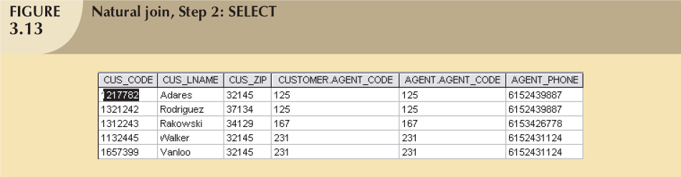
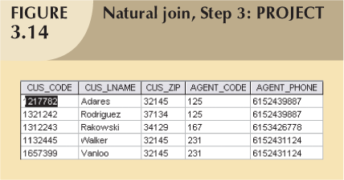

Slide 7


takes
student

Slide 8
What is the difference between the following two queries:
select *
from student S, takes T
where S.ID = T.ID;
select *
from student natural join takes

Slide 9

select *
from student S,takes T
where S.ID = T.ID

Slide 10
Outer Join
An extension of the join operation that avoids loss of information.
Computes the join and then adds tuples form one relation that does not match tuples in the other relation to the result of the join.
Uses null values to fill attributes that does not have values.

Slide 11
Outer Join (Contd. )
Natural join AND include tuples that do not have a match
Three types:
  Left outer join:
    Natural Join AND include all rows from the table in the left side even the rows that do not have a match
    Example: include all customers even those do not have a matching agent
  Right outer join:
    Natural join AND include all rows from the table in the right side even the rows that do not have a match
    Example: include all agents don’t have a matching customers
  Full outer join:
    Natural join and include all tuple from both sides even the tuples that do not have a match

Slide 12
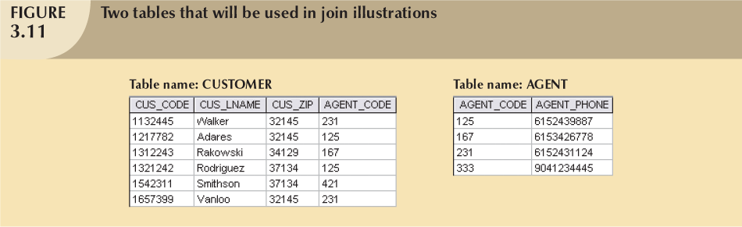
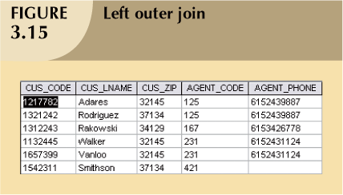
Left Outer Join
null
null
null

Slide 13
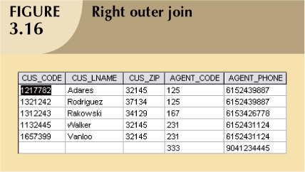
Right Outer Join
null
null
null

Slide 14

Schema Diagram for University Database

Slide 15

select *
from student S left outer join takes T on (S.ID = T.ID)

Slide 16

select *
from takes T right outer join student S on (S.ID = T.ID)

Slide 17
Views
In some cases, it is not desirable for all users to see the entire logical model (that is, all the actual relations stored in the database.)
Consider a person who needs to know an instructors name and department, but not the salary. This person should see a relation described, in SQL, by
select ID, name, dept_name
from instructor
A view provides a mechanism to hide certain data from the view of certain users.
Any relation that is not of the conceptual model but is made visible to a user as a “virtual relation” is called a view.

Slide 18
View Definition
A view is defined using the create view statement which has the form
create view v as < query expression >
where <query expression> is any legal SQL expression. The view name is represented by v.
Once a view is defined, the view name can be used to refer to the virtual relation that the view generates.
View definition is not the same as creating a new relation by evaluating the query expression
  Rather, a view definition causes the saving of an expression; the expression is substituted into queries using the view.

Slide 19
Example Views
A view of instructors without their salary
create view faculty as
select ID, name, dept_name
from instructor
A view of all instructors in the Biology department
create view biologyFaculty as
select name
from faculty
where dept_name = ‘Biology’
Create a view of department salary totals
create view departments_total_salary (dept_name, total_salary) as
select dept_name, sum (salary)
from instructor
group by dept_name;

Slide 20
Views Defined Using Other Views
create view physics_fall_2009 as
select course.course_id, sec_id, building, room_number
from course, section
where course.course_id = section.course_id
and course.dept_name = ’Physics’
and section.semester = ’Fall’
and section.year = ’2009’;
create view physics_fall_2009_watson as
select course_id, room_number
from physics_fall_2009
where building= ’Watson’;

Slide 21
Update of a View
Add a new tuple to faculty view which we defined earlier
insert into faculty values (’30765’, ’Green’, ’Music’);
This insertion must be represented by the insertion of the tuple
(’30765’, ’Green’, ’Music’, null)
into the instructor relation

Slide 22
Some Updates cannot be Translated Uniquely
create view instructor_info as
select ID, name, building
from instructor I, department D
where I.dept_name= D.dept_name;
insert into instructor_info values (’69987’, ’White’, ’Taylor’);
    which department, if multiple departments in Taylor?
    what if no department is in Taylor?

Slide 23
And Some Not at All
create view history_instructors as
select *
from instructor
where dept_name= ’History’;
What happens if we insert (’25566’, ’Brown’, ’Biology’, 100000) into history_instructors?

Slide 24
Restrictions on Updating Views
Most SQL implementations allow updates only on simple views
  The from clause has only one table
  The select clause contains only attribute names of the table, and does not have any expressions, aggregates, or distinct specification.
  Any attribute not listed in the select clause can be set to null
  The query does not have a group by or having clause.

Slide 25
Materialized Views
Materializing a view: create a physical table containing all the tuples in the result of the query defining the view
If relations used in the query are updated, the materialized view result becomes out of date
  Need to maintain the view, by updating the view whenever the underlying relations are updated.

Slide 26
Maintenance of Materialized views
Cost vs. Gain?
How often to update the view?
  Instant
  lazily
  Periodically

Slide 27
Why to use Views?
Security and Privacy
Create personalized views of data
Better performance (with materialized views)

Slide 28
Integrity Constraints
Integrity constraints guard against accidental damage to the database, by ensuring that authorized changes to the database do not result in a loss of data consistency.
  A checking account must have a balance greater than $10,000.00
  A salary of a bank employee must be at least $4.00 an hour
  A customer must have a (non-null) phone number

Slide 29
MySQL Syntax to check on constraints defined on a certain table:
select *
from information_schema.table_constraints
where table_name = <table_name>

Slide 30
Integrity Constraints on a Single Relation
not null
primary key
unique
check (P), where P is a predicate

Slide 31
Not Null and Unique Constraints
not null
  Declare name and budget to be not null
name varchar(20) not null
budget numeric(12,2) not null
unique ( A₁, A₂, …, A_{m})
  The unique specification states that the attributes A₁, A₂, … A_{m} form a candidate key.
  Candidate keys are permitted to be null (in contrast to primary keys).
  Example: to prevent duplicate invoice lines
    alter table line add
    constraint line_ui unique (inv_number,prod_code)

Slide 32
The check clause
check (P)
where P is a predicate
Example: ensure that semester is one of fall, winter, spring or summer:
create table section (
course_id varchar (8),
sec_id varchar (8),
semester varchar (6),
year numeric (4,0),
building varchar (15),
room_number varchar (7),
time slot id varchar (4),
primary key (course_id, sec_id, semester, year),
check (semester in (’Fall’, ’Winter’, ’Spring’, ’Summer’))
);

Slide 33
Referential Integrity
Ensures that a value that appears in one relation for a given set of attributes also appears for a certain set of attributes in another relation.
  Example: If “Biology” is a department name appearing in one of the tuples in the instructor relation, then there exists a tuple in the department relation for “Biology”.
Let A be a set of attributes. Let R and S be two relations that contain attributes A and where A is the primary key of S. A is said to be a foreign key of R if for any values of A appearing in R these values also appear in S.

Slide 34
Cascading Actions in Referential Integrity
create table course (
course_id char(5) primary key,
title varchar(20),
dept_name varchar(20) references department
)
create table course (
…
dept_name varchar(20),
foreign key (dept_name) references department
on delete cascade
on update cascade,
. . .
)

Slide 35
Reading
Chapter 7, complete if not yet done so:

